Slide 1
Text Classification
with Python
Build your own Text Analyzer
Delivered by: Noureddin Sadawi, PhD

Slide 2
About the Speaker
Name: Dr Noureddin Sadawi
Qualification: PhD Computer Science
Experience: Several areas including but not limited to Docker, Machine Learning and Data Science, Python and much more

Slide 3
Text Mining
“Text mining, also referred to as text data mining, roughly equivalent to text analytics, refers to the process of deriving high-quality information from text.” -wikipedia
“Another way to view text data mining is as a process of exploratory data analysis that leads to heretofore unknown information, or to answers for questions for which the answer is not currently known.” - Hearst, 1999

Slide 4
Mining
Goal-oriented (effectiveness driven)
Any process that generates useful results that are non-obvious is called “mining”.
Keywords: “useful” + “non-obvious”
Data isn’t necessarily massive
Method-oriented (efficiency driven)
Any process that involves extracting information from massive data is called “mining”
Keywords: “massive” + “pattern”
Patterns aren’t necessarily useful

Slide 5

Text mining around us
Sentiment Analysis

Slide 6
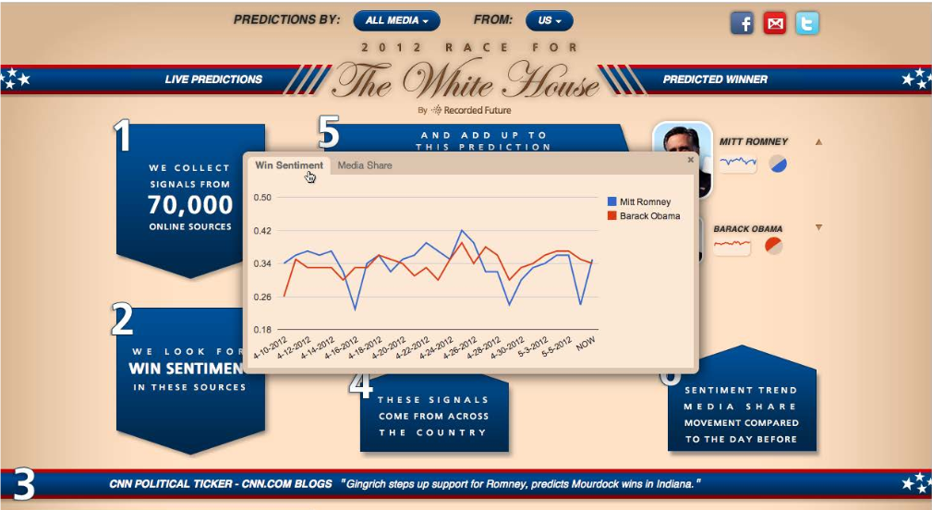
Text mining around us
Sentiment Analysis

Slide 7
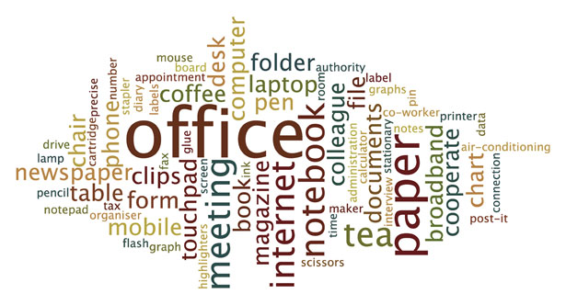
Text mining around us
Document summarization

Slide 8
Text mining around us
Movie recommendation
Restaurant/hotel recommendation
News recommendation
Text analytics in financial services
Text analytics in healthcare

Slide 9
How do we do it?
We view it as a combination of:
Data Mining + Text Data
Data Mining:
Information Retrieval
Natural Language Processing
Applied Machine Learning
Text Data:
Emails
Tweets
News Articles
Medical Docs
Blogs

Slide 10
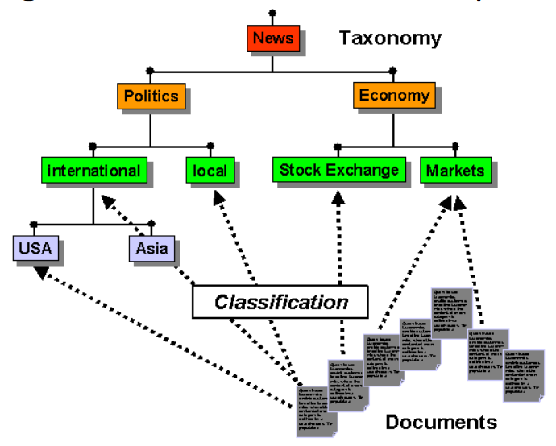
Problems we will deal with
Document/Text Categorization
Given a text document, which class does it belong to?

Slide 11
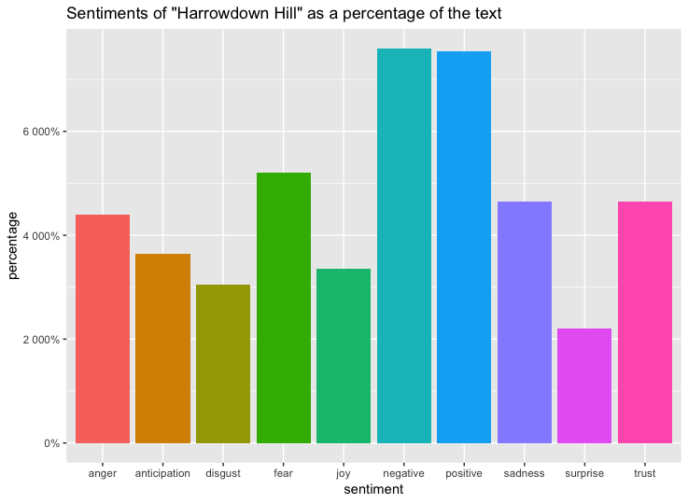
Problems we will deal with
Social media and social network analysis (Twitter)

Slide 12
Necessary Steps
To be able to automatically perform the classification task, a preliminary phase of text preprocessing and feature extraction is essential
We want to transform each text in a vector form, in which each document is represented by the presence (or frequency) of some important terms
These terms are the ones contained in the collection vocabulary
To build the vocabulary, various operations are typically performed (many of which are language-specific)

Slide 13
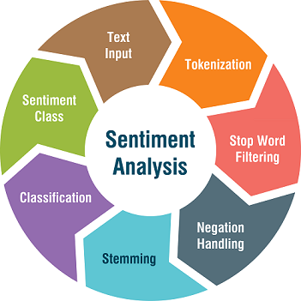
Text Classification (Sentiment Analysis)

Slide 14
Text Input
Data Collection
Data Organisation (in a table or directory structure)
Table: Your input can be in the form of a table where each row contains the text in a document and the class/category of this text
Directory: Your input can be in a directory with subdirectories inside it, each subdirectory contains text documents of the same category, the subdirectory name is the category
This needs to be transformed into a table

Slide 15
Word Parsing and Tokenization
In this phase, each document is analyzed with the purpose of extracting the terms
Separator characters must be defined, along with a tokenization strategy for particular cases such as accented words, hyphenated words, acronyms, etc
Tokenization is the term used to describe the process of converting the normal text strings in to a list of tokens (words or sentences that we actually want)

Slide 16
Words Change Meaning
“this is working. not disappointed”
“this is not working. disappointed”
After tokenization:
['disappointed’, 'is’, 'not’, 'this’, 'working']

Slide 17
NGram Tokenization
“this is working. not disappointed”
“this is not working. disappointed”
After NGRAM Transformation (window = 2):
['this is', 'is working', 'working not', 'not disappointed’]
['this is', 'is not', 'not working', 'working disappointed']

Slide 18
Stopword Removal/Filtering
A very common technique is the elimination of frequent usage words: conjunctions, prepositions, base verbs, etc
This kind of terms should be filtered as they have a poor characterizing power, making them useless for the text classification
Usually we use a predefined list of stopwords

Slide 19
Negation Handling
Negation handling is an automatic way of determining the scope of negation and inverting the polarities of opinionated words that are actually affected by a negation
Usually, in simple sentence (i.e. sentence contains only one clause) a negation may invert the polarities of all words in a sentence
http://www.jcomputers.us/vol12/jcp1205-11.pdf
Negation handling is quite a broad field, with numerous different potential implementations

Slide 20
Lemmatization and Stemming
The lemmatization of a word is the process of determining its lemma
The lemma can be thought of as the “common root” of various related inflectional forms
for instance, the words walk, walking and walked all derive from the lemma walk
A simple technique for approximated lemmatization is called stemming
Stemming algorithms work by removing the suffix of the word, according to some grammatical rules

Slide 21
Term Selection and Feature Extraction
The term set resulting from the previous phases has still to be filtered, since we need to remove the terms that have poor prediction ability (w.r.t the document class) or are strongly correlated to other terms
This term selection task also leads to a simpler and more efficient classification
A common powerful technique for feature extraction based on word importance is the Term Frequency - Inverse Document Frequency, or TF-IDF for short

Slide 22
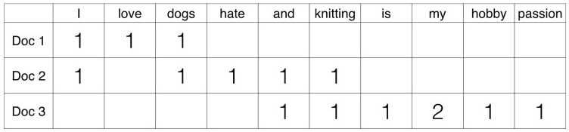
Term Frequency
In TF we just count the number of words occurred in each document
Term frequency is basically the output of the BoW model
Essentially it is a frequency table showing how many times each word appears in each document/tweet
The main issue with this Term Frequency is that it will give more weight to longer documents

Slide 23
Term Frequency
This matrix is using a single word
It can be a combination of two or more words
It is called a bigram or trigram model and the general approach is called the n-gram model (a tokenization approach)

Slide 24
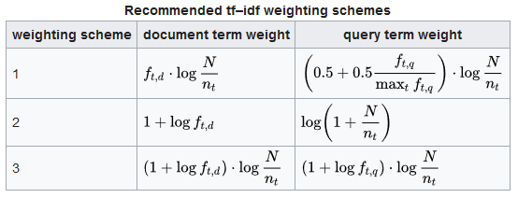
Inverse Document Frequency
IDF measures the amount of information a given word provides across the document
It is the logarithmically scaled inverse ratio of the number of documents that contain the word and the total number of documents
https://en.wikipedia.org/wiki/Tf%E2%80%93idf

Slide 25
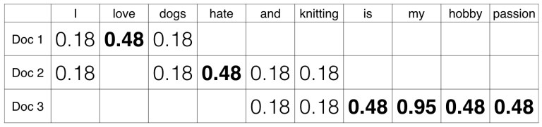
TF-IDF
TF-IDF normalizes the document term matrix
It is the product of TF and IDF
If word has a high tf-idf in a document, it appears most of the time in this document .. and much less times in the other documents
So the word must be a signature word (i.e. important)

Slide 26
Classification
This is a supervised learning task
The idea is to train a classifier on existing labelled data and then assign a class label to unclassified input
It is important to bear in mind that the same preprocessing steps used to prepare the training data must be applied to the new data
After this you can use your favourite classifier
NaiveBayes usually works well in text classification

Slide 27
Example Data
There are several freely available datasets
A common one is the 20 Newsgroups Dataset:
http://qwone.com/~jason/20Newsgroups/
Movie Sentiment Data:
https://github.com/adamwulf/movie-review-sentiment-data

Slide 28
Nice Papers
Text Classification Algorithms: A Survey:
https://arxiv.org/pdf/1904.08067v4.pdf
Deep Learning Based Text Classification: A Comprehensive Review:
https://arxiv.org/pdf/2004.03705.pdf

Slide 29
Course Notebooks and Data
Available here:
https://drive.google.com/open?id=1nF9HkZTlRE1fylyZA4oMOt0Ib_OGcQLz
And on Github:
https://github.com/nsadawi/Advanced-ML-Projects

Slide 30


